Slide 1


maulana Azad National Institute of technology
Minor project – CA 308
Car Buddy (CaR Rental System)
Mca 2nd Year (3rd Sem)
Under Guidance of :
Dr. Sanjay sharma

Slide 2


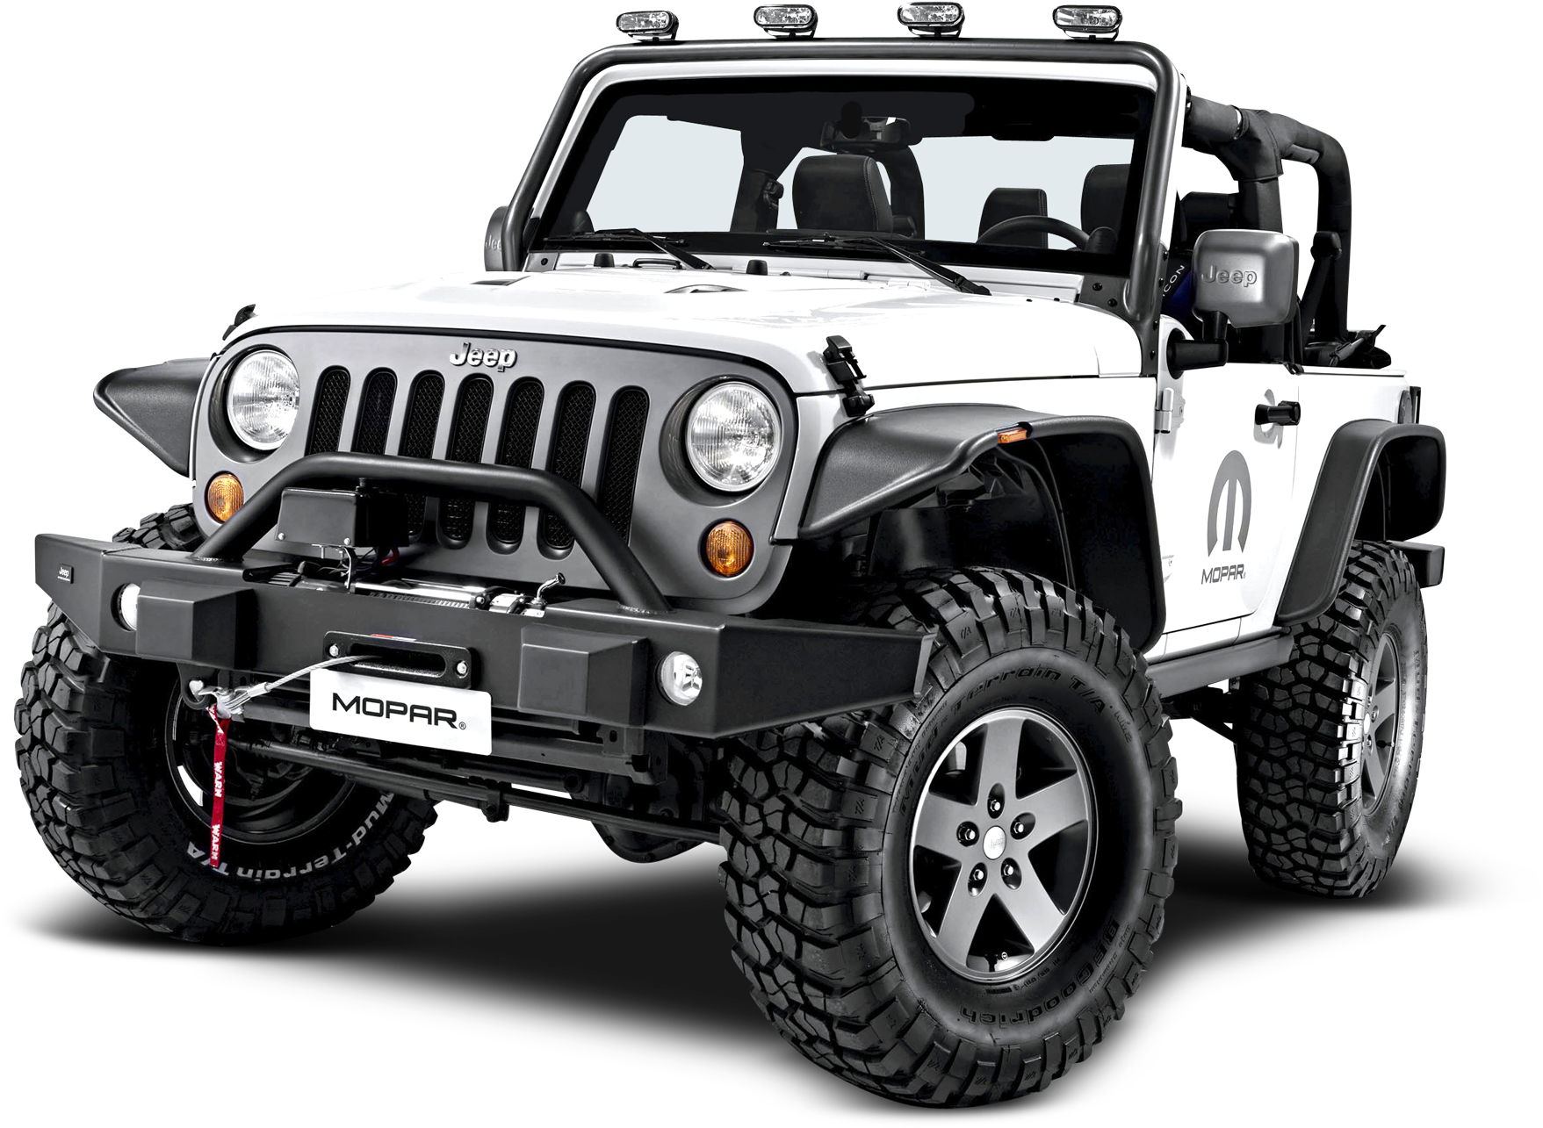

Car Buddy
ALWAYS THEIR FOR YOU

Slide 3

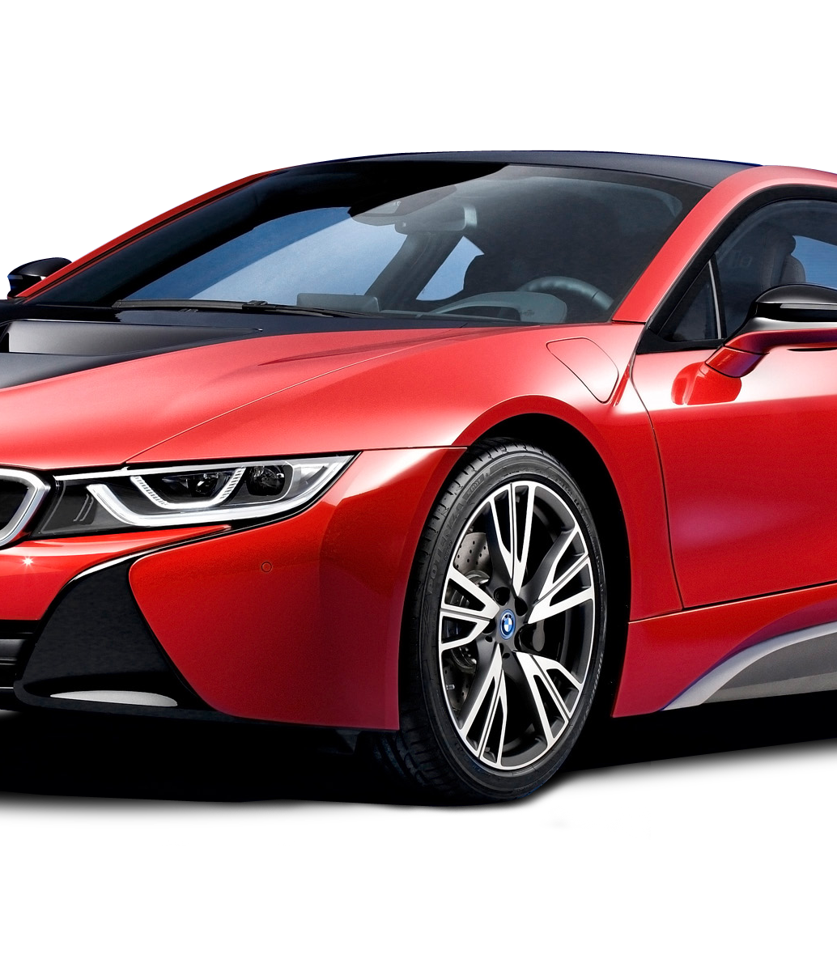
INTRODUCTION
We have chosen to produce a Car Rental system. In our system, Customer can rent a car based on make and a model.
Our system provides customer to have different pick-up and drop-off locations and will impose late fee if the rental car is returned beyond the return date and time.

Slide 4


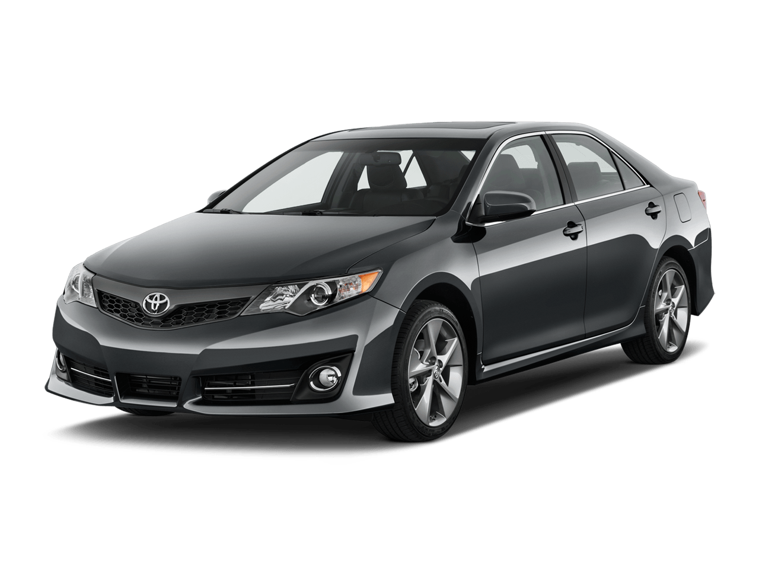
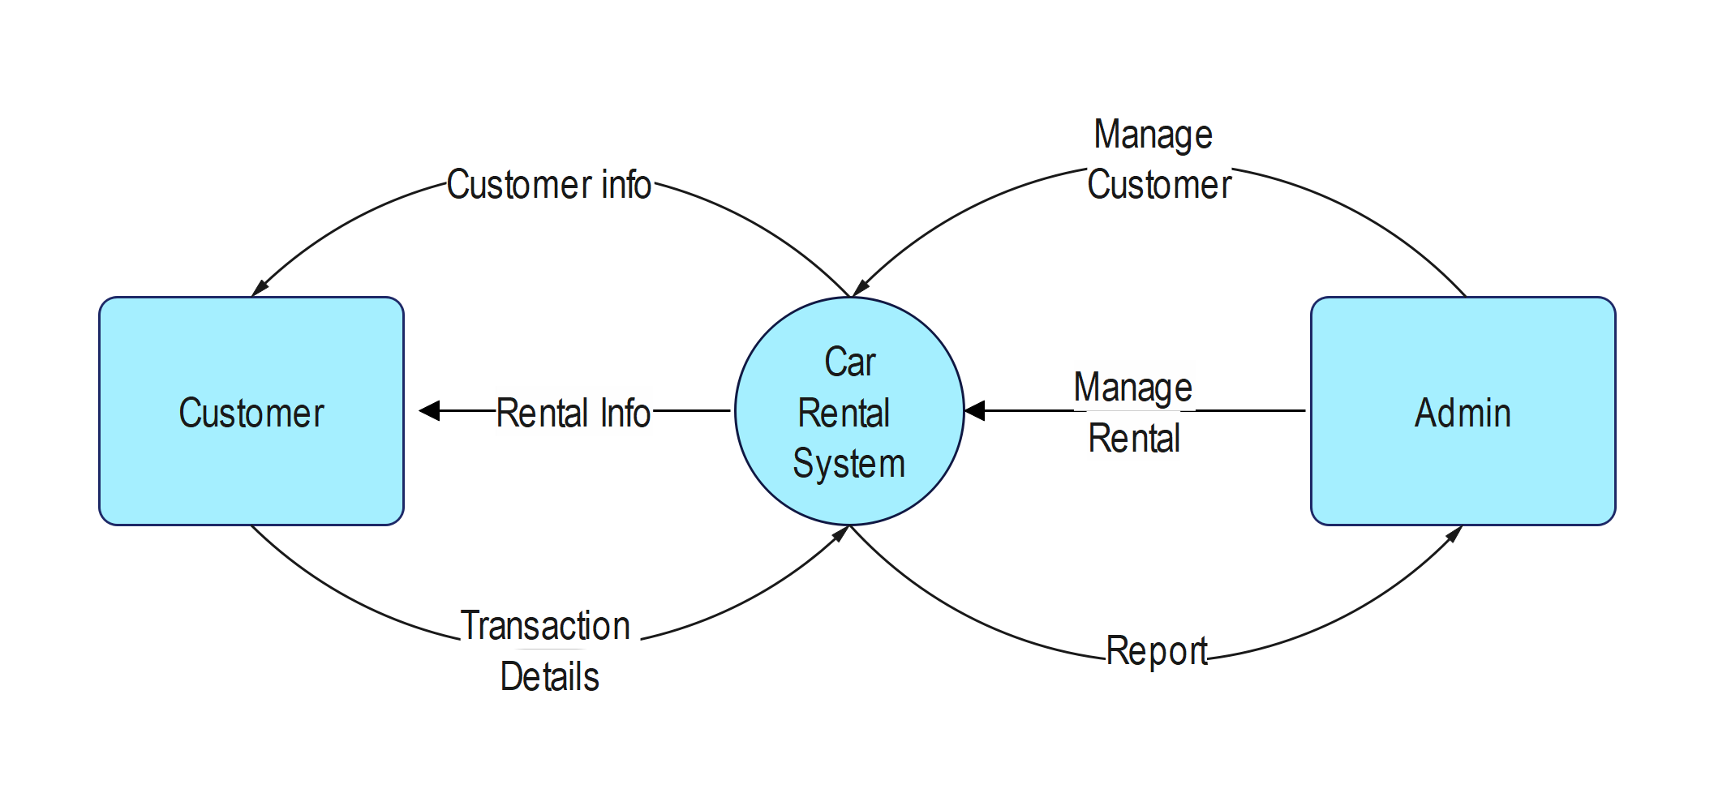

Data Flow
Diagram
Level 0

Slide 5
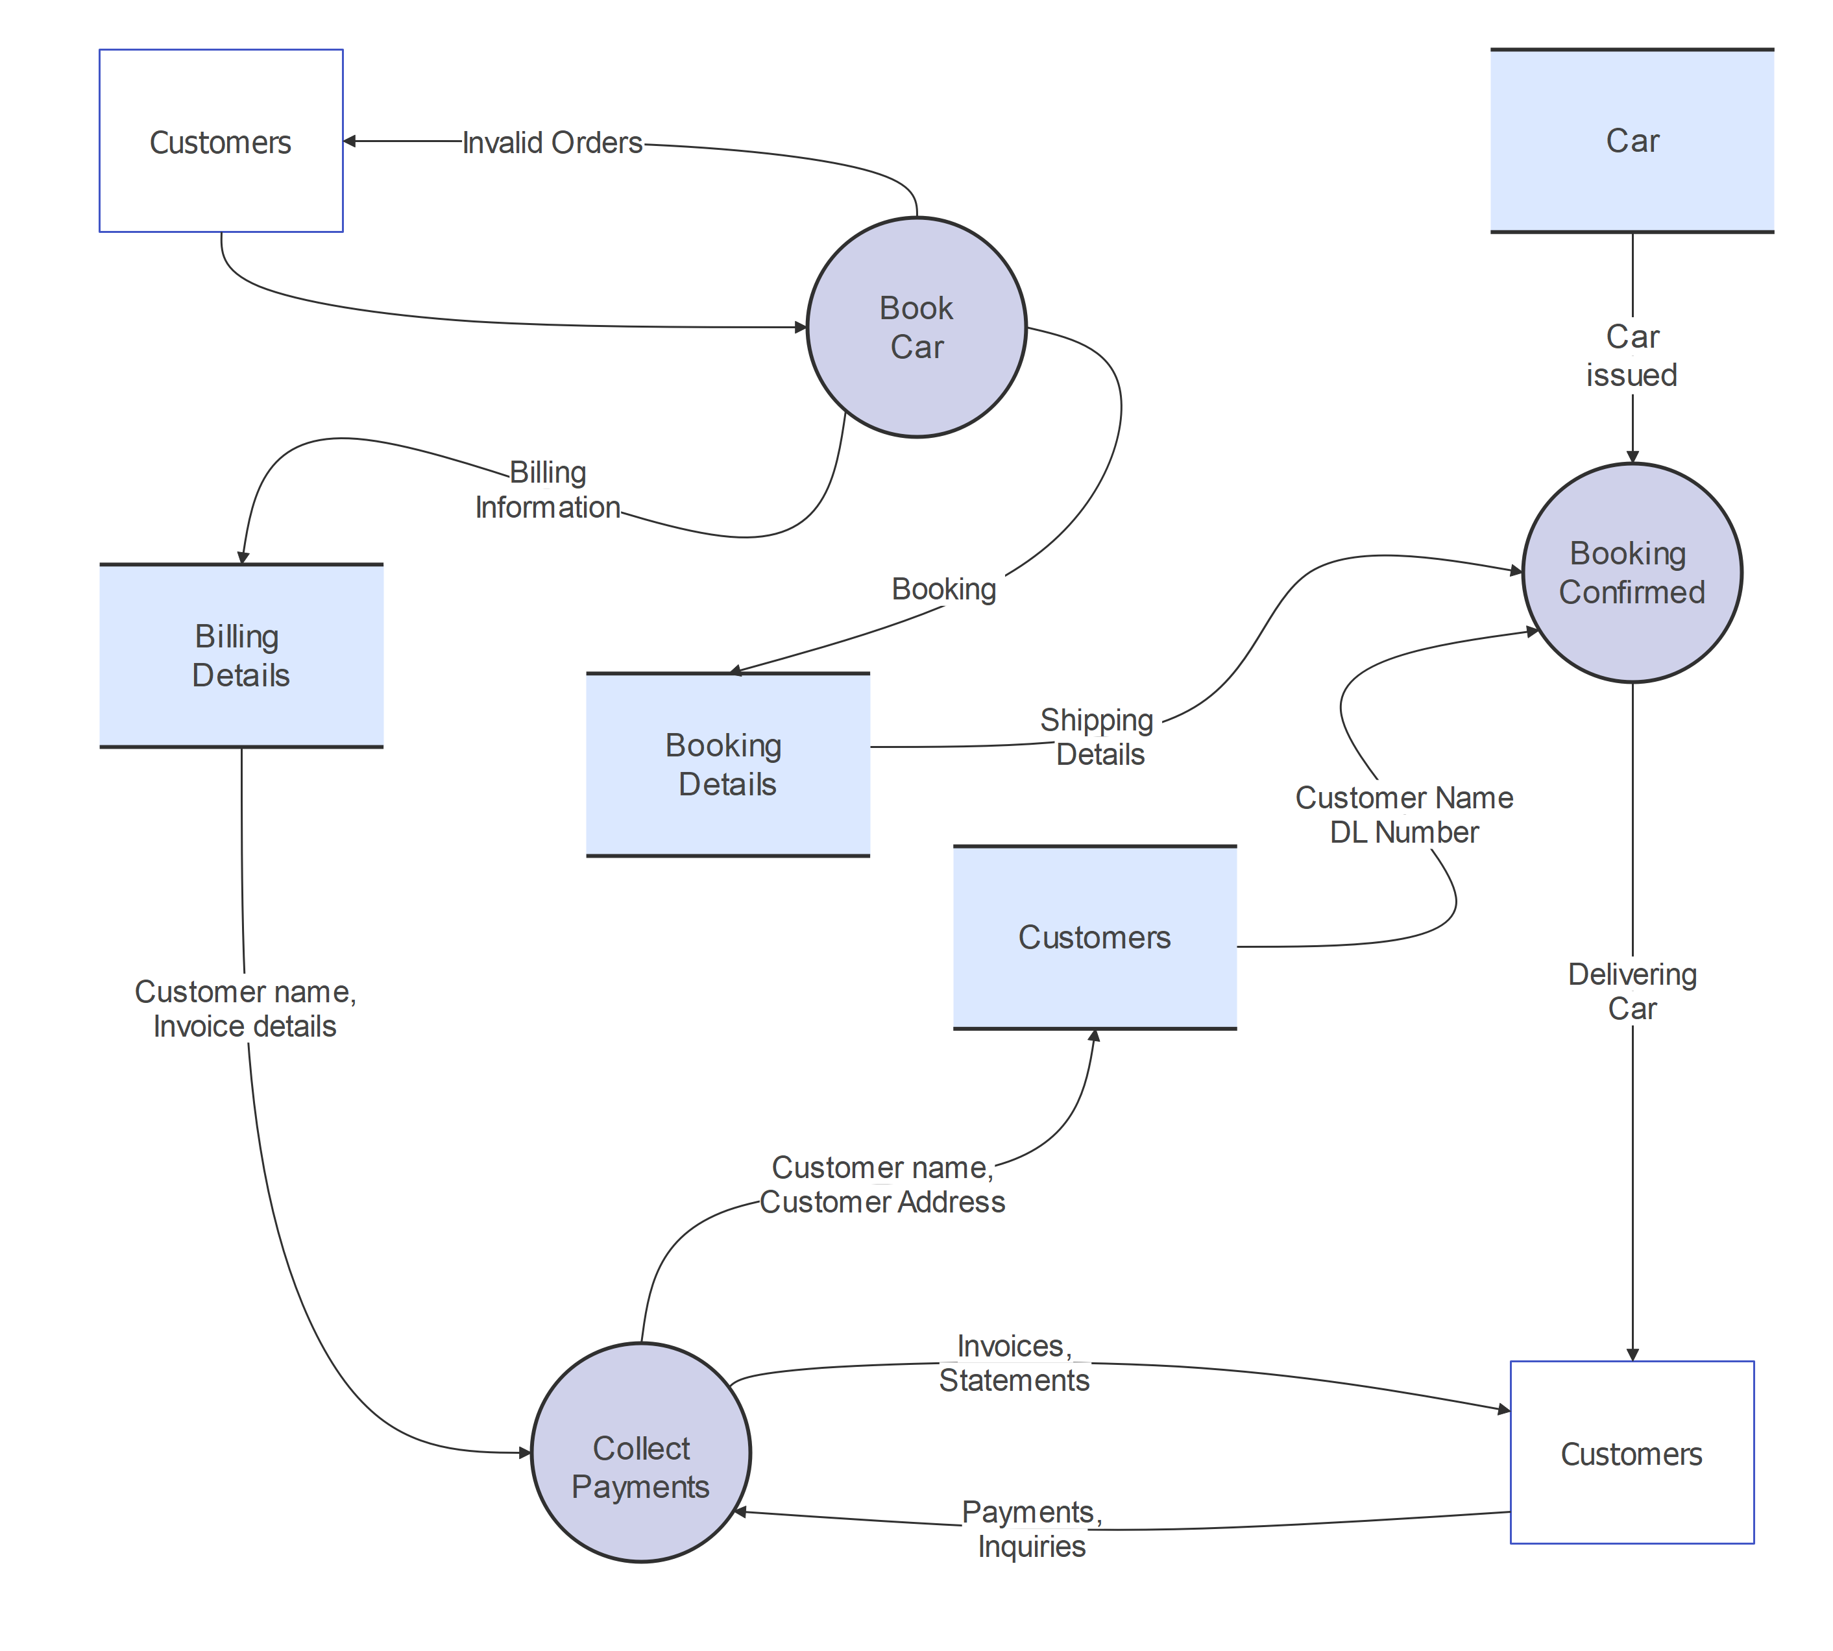
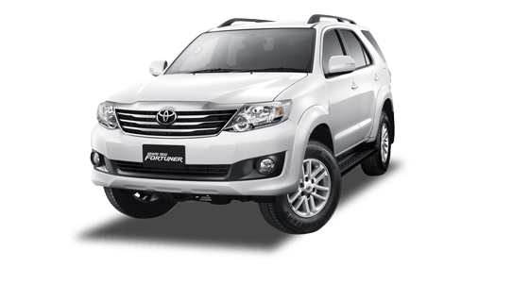
Data Flow
Diagram
Level 1

Slide 6
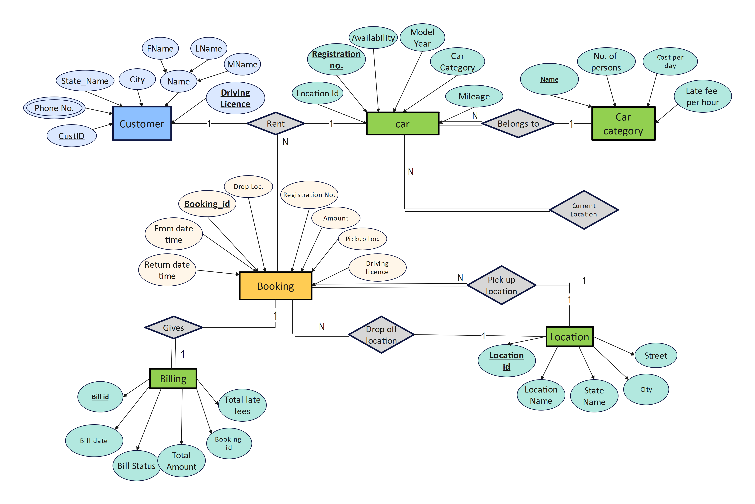
E-R
DIAGRAM

Slide 7
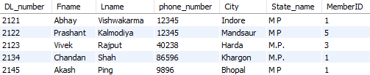
CUSTOMER DETAILS TABLE (WITH DUMMY DATA)

Slide 8
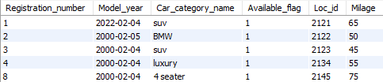
CAR DETAILS TABLE (WITH DUMMY DATA)

Slide 9
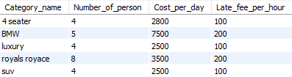
CAR CATEGORY DETAILS TABLE (WITH DUMMY DATA)

Slide 10
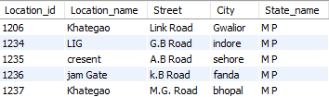
LOCATION DETAILS TABLE (WITH DUMMY DATA)

Slide 11
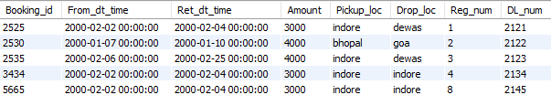
BOOKING DETAILS TABLE (WITH DUMMY DATA)

Slide 12
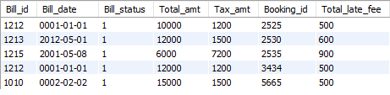
BILLING DETAILS TABLE (WITH DUMMY DATA)

Slide 13
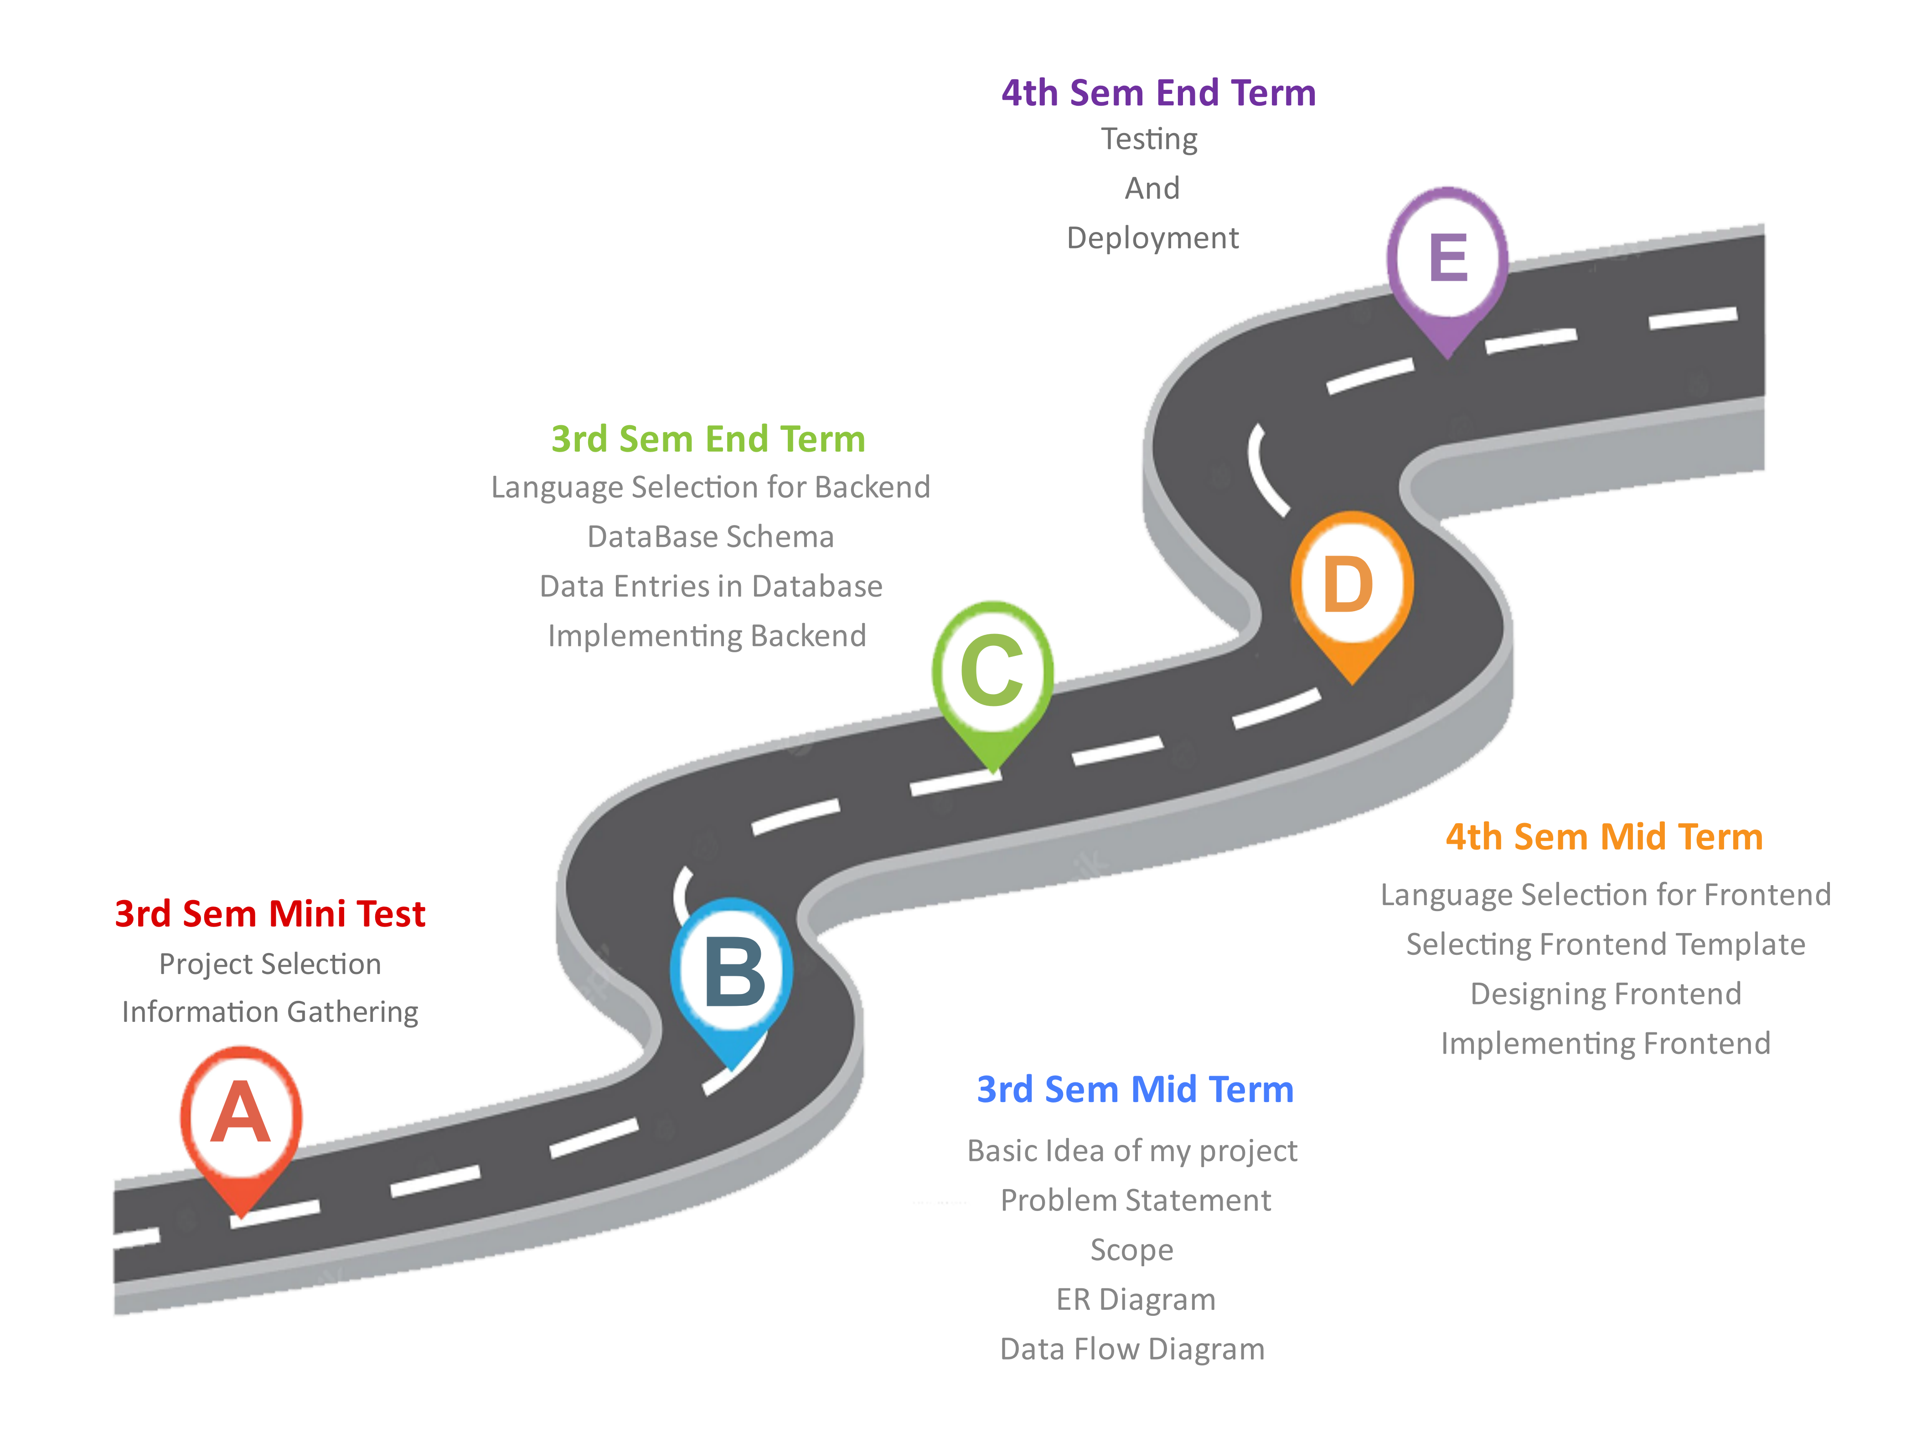
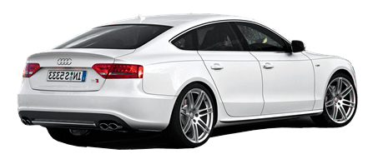
ROADMAP
FOR
CAR BUDDY
(Car Rental Services)

Slide 14
OUR TEAM
Prashant Kumar Kalmodiya
212120021
Abhay Vishwakarma
212120013

Slide 15
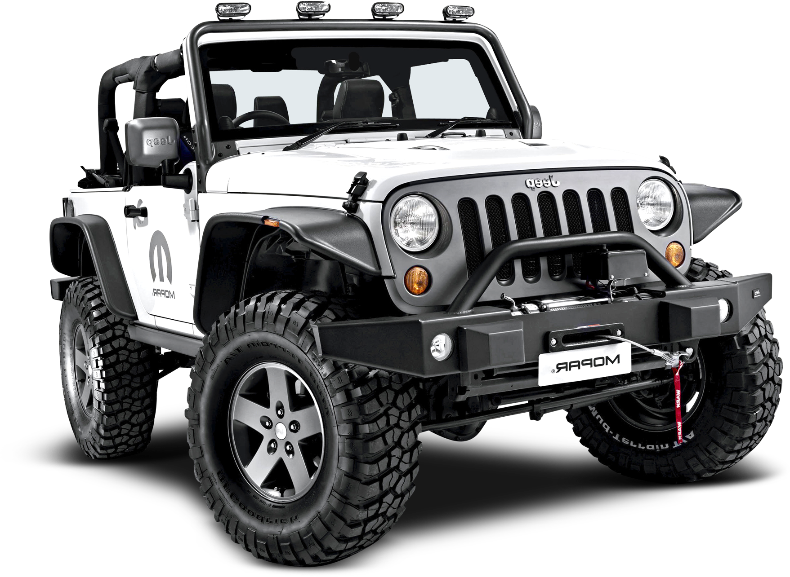
THANK
YOU

